Slide 1



Introduction to Genetics and Evidence Routines
Day 1: Building Scientific Observation Skills in Genetics
Aaron Esbenshade — Biology
Dock Mennonite High School
March 2026

Slide 2



Lesson Objectives
By the end of today's lesson, you will be able to:
Describe genes, chromosomes, and DNA using accurate biological vocabulary and understand their relationships.
Explain inheritance as the passing of biological information from parents to offspring through genetic mechanisms.
Practice the observation-to-explanation routine that will anchor all Unit 4 investigations and scientific thinking.

Slide 3


In-Class Activities Overview
Today's Learning Journey
Five structured activities to build genetics vocabulary and observation skills.
Bellwork
8 min
Mini-Lesson
15 min
List inherited traits and distinguish observations from inferences.
Introduction to DNA, genes, chromosomes, and evidence routine.
Guided Practice 1
25 min
Guided Practice 2
25 min
Analyze trait photos and sort observation, evidence, explanation statements.
Build class concept map linking DNA, genes, proteins, and traits.
Debrief
10 min
Write claim-evidence-reasoning response about inheritance.

Slide 4


Bellwork Challenge (8 minutes)
Your Mission
8 minutes
1
List 2-3 inherited traits you observe in both parents (eye color, height, hair texture).
2
List 1-2 inherited traits you observe in only one parent.
3
Make an inference about each trait Is the trait dominant, recessive, from Mom, from Dad
Observation Examples
Inference Examples
"My mom has brown eyes and dad has blue"
"Brown eyes are dominant since I have brown eyes"
"I am tall and my mom is short but my dad is tall"
"I got my height from my dad"
"Both parents have blonde hair"
"I have blonde hair my genotype may be homozygous"

Slide 5


Key Terms - Building Our Genetics Vocabulary
Heredity
DNA
The passing of biological information from parents to offspring through genes.
Deoxyribonucleic acid - the molecule that contains genetic instructions for life.
Gene
Chromosome
A specific section of DNA that codes for a particular trait or characteristic.
A structure containing many genes organized together in the cell nucleus.
Trait
An observable characteristic of an organism, such as eye color or height.

Slide 6

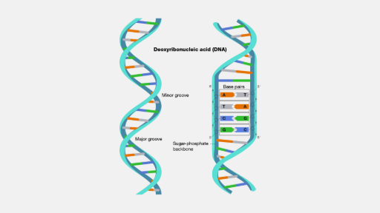

DNA - The Blueprint of Life
What is DNA?
DNA stands for deoxyribonucleic acid, containing genetic instructions.
It has a double helix structure, like a twisted ladder.
The sequence of bases (A, T, G, C) forms the genetic code .
DNA can replicate itself to pass information to new cells.
Amazing DNA Facts
If unraveled, all DNA in your body would stretch 10 billion miles!

Slide 7





The Evidence Routine - Our Scientific Method
1. OBSERVE
→
2. CITE EVIDENCE
→
3. EXPLAIN
What do you see? Record only what is directly observable.
What specific data supports your observation?
Why might this be happening? What's the scientific reasoning?
Example: Family Eye Color Study
Observe
Evidence
Explain
"Both parents have brown eyes , but one child has blue eyes ."
"Family photos show consistent eye colors across multiple generations."
"Parents likely carry recessive alleles for blue eyes that combined in this child."

Slide 8






From DNA to Traits - The Connection
DNA
Genes
Chromosomes
Traits
The genetic material containing instructions
Specific sections of DNA coding for traits
Structures organizing many genes together
Observable characteristics we can see
The Big Picture
DNA contains the instructions, genes are specific recipes within that instruction manual, chromosomes organize these recipes into chapters, and traits are the final products we observe in living organisms.

Slide 9









Observation vs. Inference - Can You Tell the Difference?
Observations
Inferences
What we can directly see, hear, or measure
What we conclude or interpret from observations
"This student has brown eyes" - directly observable trait
"Brown eyes are dominant" - conclusion about inheritance
"The plant is 15 cm tall" - measurable characteristic
"The plant has good genes" - interpretation of growth
"Both parents have curly hair" - visible family trait
"The child will have curly hair" - prediction based on parents
"The DNA gel shows three bands" - laboratory result
"This gene causes the trait" - explanation of DNA results

Slide 10
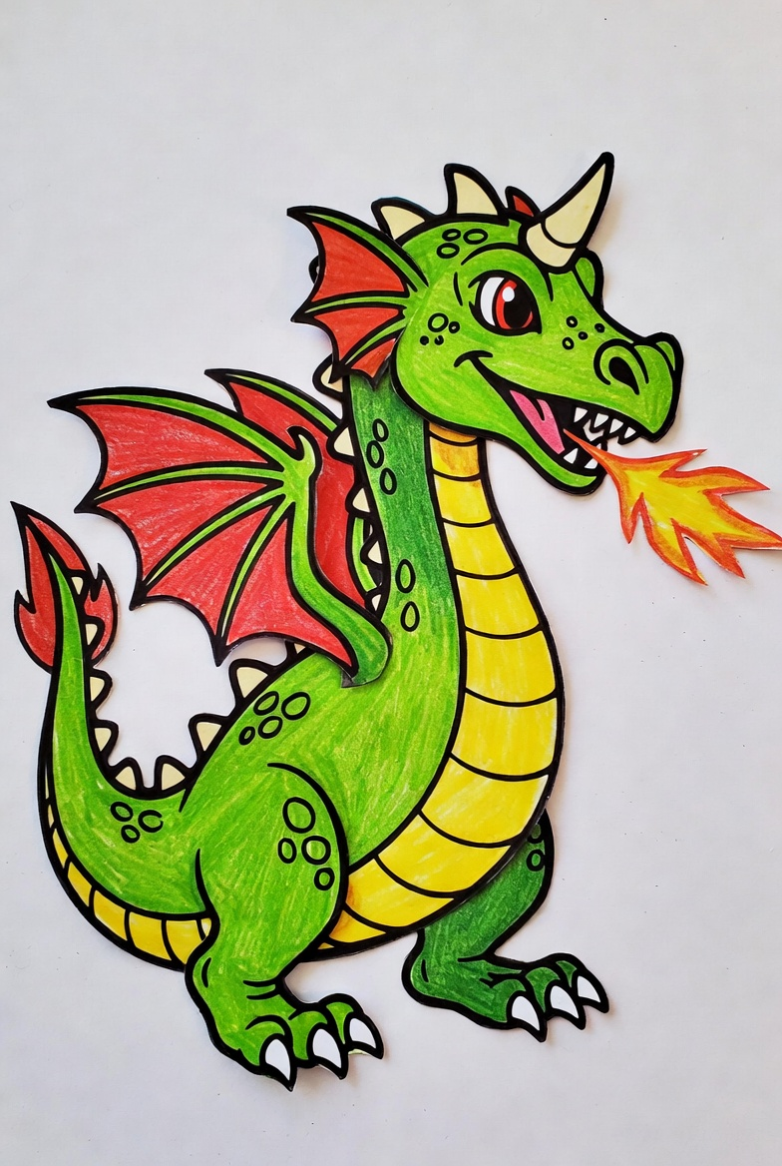

Dragon Genetics Lab
Activity Instructions
In this activity you will “mate” with a dragon of the opposite gender to create a “baby dragon.” You will use your knowledge of genetics to determine the genotype and phenotype for each of the 13 traits in your baby dragon. You will also construct a picture of your baby dragon by cutting out the appropriate pieces from the blackline drawing (page 8), taping/gluing them in place, and coloring them correctly.
Pink (girl) and Blue (boy) will exchange genetic information in order to create their dragon

Slide 11



Exit Ticket Reflection
What is one genetics claim you can make about the traits you observed in your bell work? Support it with what you learned from today’s lesson.
Write your response using the format: Claim → Evidence → Reasoning
Assessment Purpose
This reflection helps us assess your understanding of the observation-to-explanation routine and your ability to distinguish between what you directly observe and the scientific claims you can support with evidence.

